Slide 1
Salmonid Natural History
Species and History

Slide 2
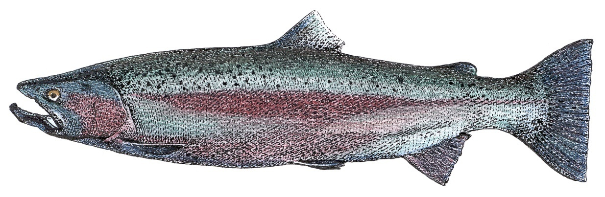
Salmonid Species and History
The family Salmonidae consists of a variety of salmon and trout species in several phylogenetic branches.
The Pacific salmon, rainbow trout, and cutthroat Trout are all in the genus Oncorhynchus.
Notes:
The genus Oncorhynchus can be considered the “Pacific salmon” because all of the species in that genus live in the northern Pacific ocean. Only one species of Pacific salmon (Masu salmon of Japan and Siberia) does not live on the Pacific coast of North America. Cutthroat trout only live in North America.

Slide 3
Relationships the Salmonids
Pacific salmon
Onchoryhnchus
rainbow trout
Pacific Salmon
cutthroat trout
Atlantic salmon
Adriatic trout
Salmonidae
Salmo
brown trout
bull trout
Salvelinus
chars
Dolly Varden
Arctic char
Hucho
taimen
Brachymystax
lenoks
Thymallus
graylings
From Smith and Stearly 1989
bold represents fish of the Pacific Northwest
Notes:
Pacific salmon are in genus Oncorhynchus in the family Salmonidae. Pacific salmon are most closely related to the Salmo genus of trout, which includes Atlantic salmon and the European brown trout. Another related branch are the “char” in the genus Salvelinus which has a circumpolar distribution. Chars of western North America include the bull trout, Dolly Varden, and arctic char.
The other more ancient branches of salmonid fish mostly live in Asia, with the exception of the pan-boreal graylings.

Slide 4
Relationships within Oncorhynchus
nerka
Sockeye
gorbuscha
Pink
keta
Chum
kisutch
Coho
Pacific salmon
tsawytscha
Chinook
masou
Masu
irideus
Rainbow trout
mykiss
mykiss
aguabonita
Golden trout
rainbow trout
chrysogaster
Mexican golden trout
Oncorhyhchus
gilae apache
Apache trout
gilae
gilae gilae
Gila trout
clarki
cutthroat trout
Consensus tree; Conservation Biology, Volume 8, No. 3, Sept 1994
Notes:
Phylogenetic tree for the genus Oncorhynchus.
There are three primary subgroups within this genus. The Pacific salmon, the rainbow trout, and the cutthroat trout.
We’ll now look at how these three groups evolved and branched in isolation due to changes in the landscapes and river systems during the last ice age.

Slide 5
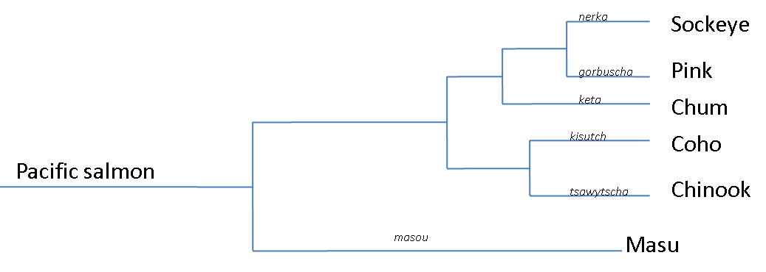
Pacific Salmon Relationships
Notes:
Within the Pacific Salmon group, Chinook and Coho are together in related branch, while Chum, Pink, and Sockeye make up another. Masu is a more ancient branch of Pacific Salmon limited only to northern Asia.
It is unclear how or why the Pacific salmon branched the way they did, but it seems as those these branches occurred before the last ice age. However, the ice age did play a role in determining which river systems they occupy today.

Slide 6
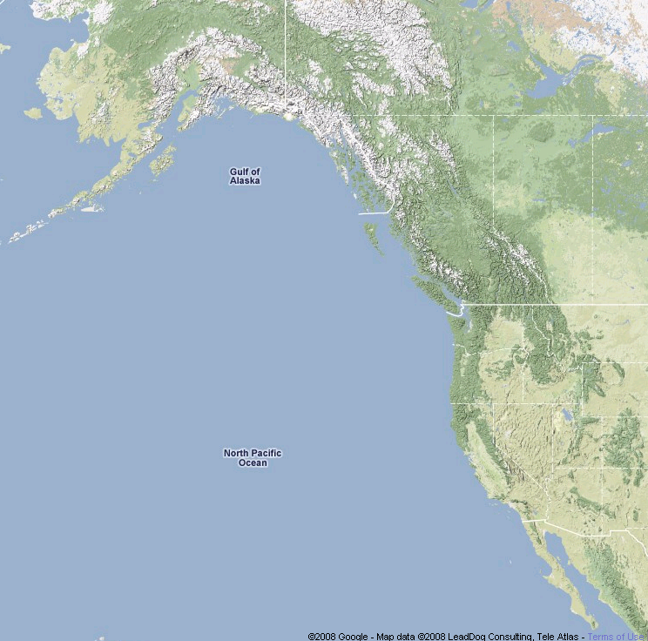
Colonization by Pacific Salmon
Notes:
The current distribution of Pacific salmon species is directly related to the ice ages. During that time, ice sheets filled many of the valleys and prevented access to much of the continent. Salmon needed to find refugia in ice free regions such as interior Beringia (the land bridge between Alaska and Siberia), as well as, the more southern coastal areas from Washington to Baja California.
Once the ice melted, salmon were able to recolonize many of the rivers throughout the west, nearly all the way to the Continental Divide. However, anadromous Pacific salmon were never able to colonize east of the divide, the Great Basin, or the southern Rocky mountains. This is probably related to the location of ice dams and other barriers during this time.

Slide 7
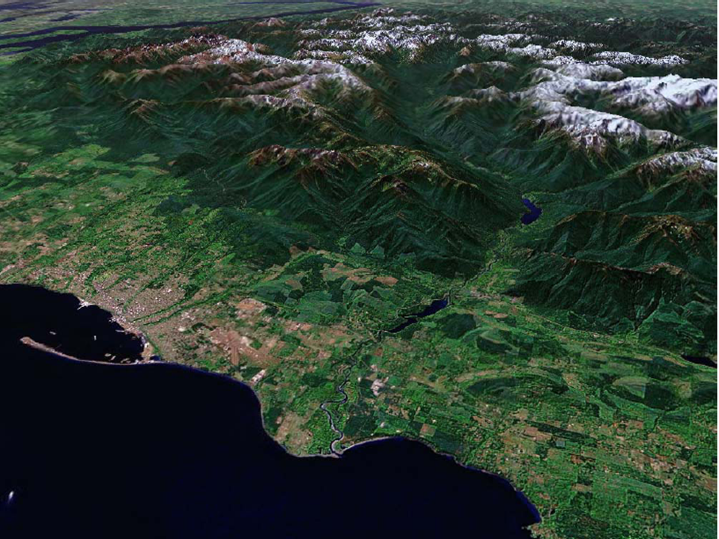
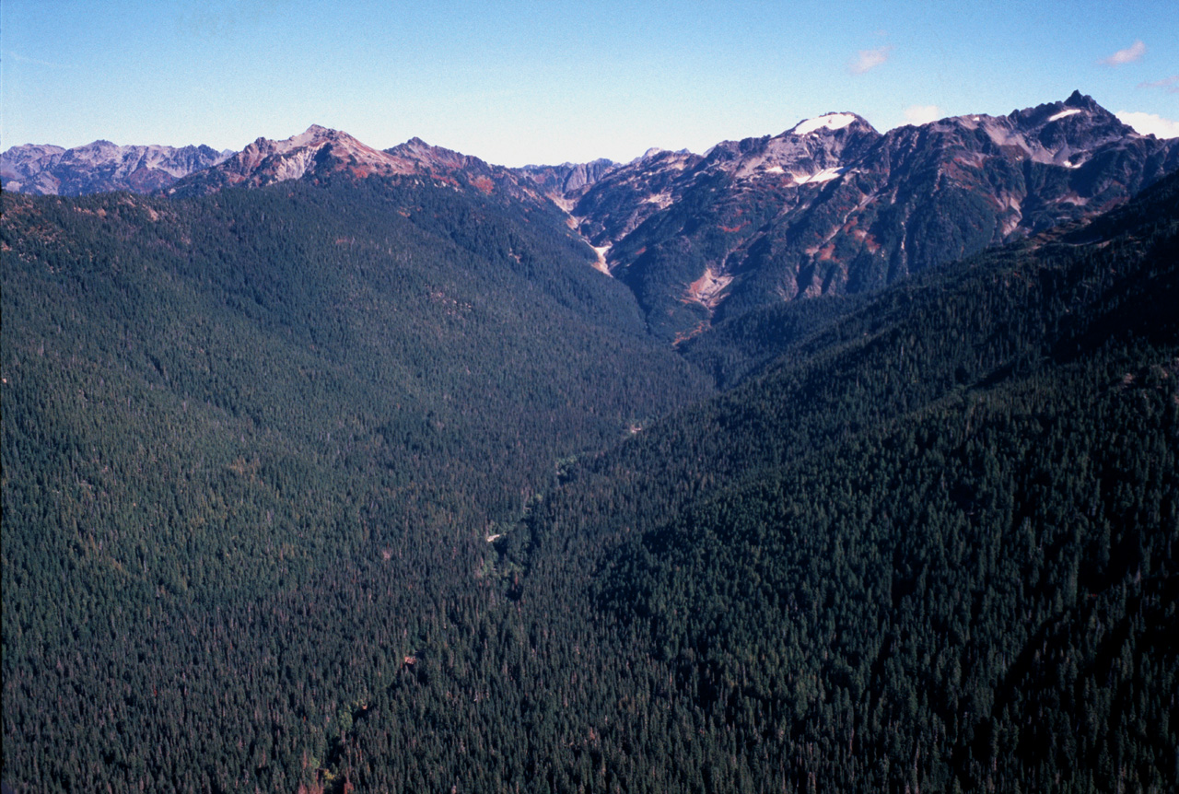
Glacial Lake Elwha
Salmon Colonization of the
Elwha river watershed
Notes:
Salmon Colonization of the Elwha river watershed.
Prior to the end of the Ice Age, Glacial Lake Elwha was formed by melt water that was impounded by the thick ice sheet that filled the Strait of Juan de Fuca. Once the ice melted and the lake drained, Pacific Salmon species were able to colonize the Elwha river valley.

Slide 8
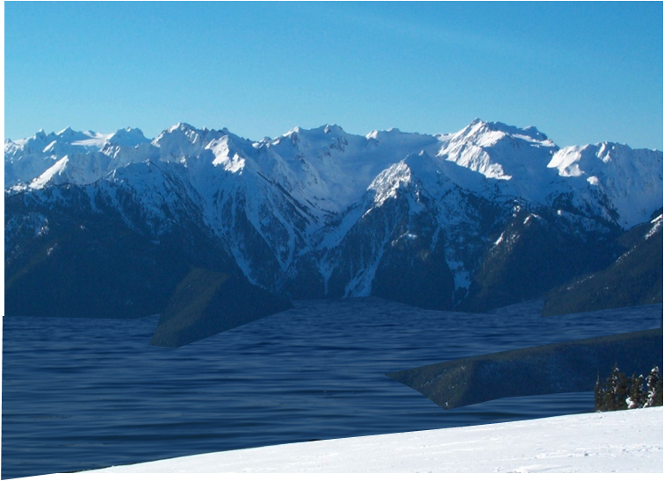
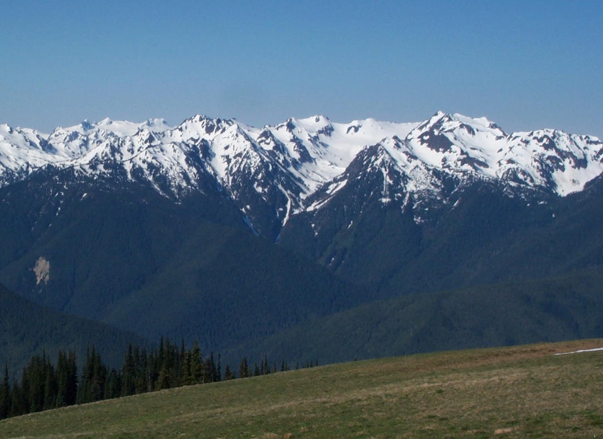
After the Ice
But, as the glaciers receeded and the lake drained, new land was exposed and forests began to reclaim the valleys.
While ice filled the strait, salmon and other fish could not migrate into the Elwha Valley.
Notes:
A view of what Glacial Lake Elwha might have looked like during the ice age from the top of Hurricane Ridge. The second image is the same view from Hurricane Ridge today.

Slide 9
Relationships of the Rainbow trout (mykiss)
irideus f. beardsleei
Beardslee trout
irideus
Coastal Rainbow trout
nelsoni
San Pedro Mártir trout
Rainbow trout
gairdnerii
Columbia redband trout
newberrii
Great Basin redband trout
Mykiss
aguabonita
California golden trout
Golden trout
f. whitei
Little Kern River golden trout
chrysogaster
Mexican golden trout
Rio Yaqui trout
Mayo trout
Rio Piaxtla trout
Rio San Lorenzo trout
Notes:
A phylogenetic tree of the rainbow trout branch. The anadromous coastal rainbow trout (steelhead) was the source for all of these populations. Those who migrated to the more southern waters branched into the golden trout group (either via the San Joaquin and Kern Rivers into the Sierra Nevada to become California golden trout or via the rivers of the Mexican Pacific coast into the Sierra Madre for Mexican golden trout). The third major branch were the Gila/Apache trout which migrated up the Gila river from the Gulf of California.
In all of those cases, as the climate warmed following the ice age, the lower sections of the rivers either reached lethal temperatures or dried up completely, leaving them isolated in high mountain streams.
In the modern rainbow trout branch, Columbia Redband trout and Great Basin Redband trout traveled up the Columbia and Snake rivers and entered the endoheric basins via the pluvial lakes of the ice age. They evolved to arid conditions as the climate warmed.
San Pedro Martir trout of Baja were steelhead who migrated into the mountains in the Baja Peninsular ranges and became trapped by the warming climate.
The Beardslee trout became trapped in Lake Crescent in Washington following the ice age when a large landslide blocked Indian creek and filled the lake.

Slide 10
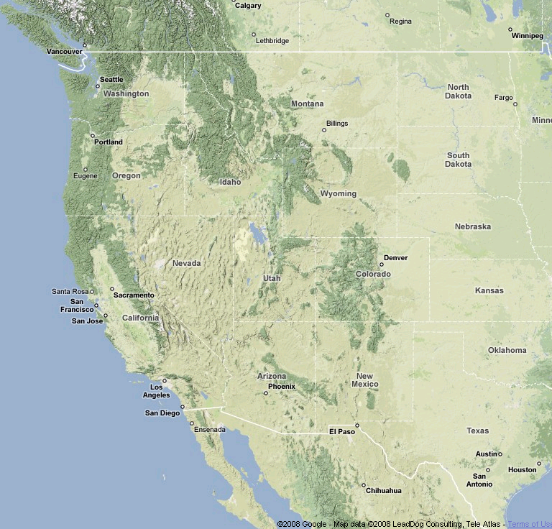

Rainbow Trout Colonization and Evolution
Notes:
Rainbow trout can tolerate a particularly wide range of environmental conditions compared to other Pacific salmon, including warmer water temperatures than most salmon can tolerate and the ability to live in a wide range of aquatic habitats including small streams, large rivers, lakes, and the ocean. Their ability to either be resident or anadromous have allowed them to survive in areas when they are cut off from the sea, as well as, the ability to recolonize newly available rivers from the ocean when glaciers melt.
These are the characteristics that have made rainbow trout such a popular fish to stock in rivers and lakes around the world, as well as, for trout farms.
During the ice age, sea temperatures were colder than today, allowing steelhead to migrate as far south as central Mexico. Steelhead were able to migrate up the once flowing Gila river in Arizona all the way to the headwaters in central Arizona (Salt river to the White mountains) and western New Mexico (Gila wilderness). However, after the ice age ended, the lower Gila river warmed up to lethal temperatures and dried out in places and the trout were genetically isolated in the high mountain streams. This isolation resulted in them evolving into the Apache and Gila trout.
During the ice age, pro-glacial lakes in the Great Basin overflowed across mountain divides and down to the Snake river. These connections allowed steelhead to migrate up into these previously inaccessible areas. When the ice age ended and these lakes dried up, and steelhead remained as isolated populations in the surrounding mountains to become the Great Basin Redband trout.
In addition, a population trapped in the Sierra Nevada mountains in the Kern river watershed (which no longer flows to the sea) has become the California Golden trout.

Slide 11
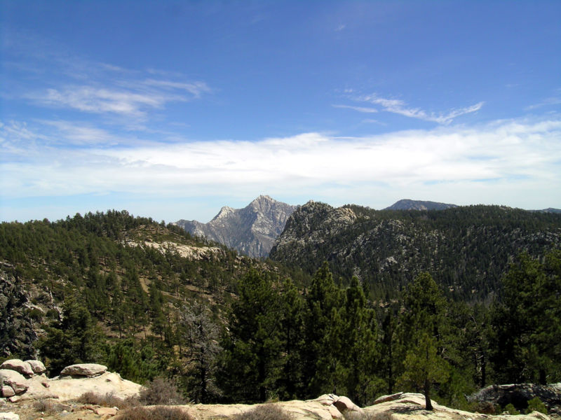
Trout of Mexico
Notes:
Steelhead also colonized high mountains streams in the Sierra Madre of Mexico and have long been cut off genetically. These unique Mexican forms are now limited to small stretches of streams high in the mountains and are threatened with extinction due to habitat loss by forestry (which provides shade for the streams), mining (which contaminates the streams with silt and chemicals), and overfishing.

Slide 12
Relationships of the Cutthroat trout (clarki)
lewisi
Westslope
alvordensis
Alvord
Lower Snake river spp.
henshawi
Lahotan
seleniris
Paiute
cutthroat trout
Clarki clarki
Coastal
f. crescentii
Crescenti
utah
Bonneville
Upper Snake river spp.
bouvieri
Yellowstone
pleuriticus
Colorado River
macdonald
Yellowfin
stomias
Greenback
virginalis
Rio Grande
Bold indicates major subspecies, non-bold is a minor subspecies, talics indicates now extinct, small font indicates not likely a true subspecies, but rather a form
Notes:
This is the generalized phylogenetic tree for the cutthroat trout branch. You can work through the order of isolation based on how tree branches and geographic locations that they currently occupy. There are 12 subspecies of cutthroat trout.
Like rainbow trout, cutthroat are very tolerant of different river conditions, including small streams, large rivers, lakes, and the ocean. This flexibility has allowed it to survive major events such as the ice age, dammed river (whether natural or man-made), and warming water temperatures.
Cutthroat trout occupy the largest climatic range of any of the Pacific salmon species, including virtually every river system on the Pacific coast, in the Great Basin, and they are the only species of the genus to cross the continental divide into rivers feeding east.

Slide 13
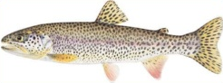
Cutthroat Trout Colonization and Evolution
Notes:
Here is an animation of the possible movement of cutthroat trout across western North America during the ice age and after. There are 12 subspecies of cutthroat trout and many of them have found themselves isolated in mountain streams east of the continental divide and in the endoheric Great Basin. One of the most important transport mechanisms were the existence of ice age pluvial lakes, such as Glacial Lake Bonneville (the remnants of which are the Great Salt Lake today) and Glacial Lake Lahotan in Nevada. As these lakes filled and spilled over the divides into the Snake River plain, cutthroat trout were able to cross the divide and enter these endoheric systems. As the ice age ended and these lakes dried up, not only did they find themselves isolated from the Snake river, but it also forced them into remote mountain streams at high elevations that fed into the Great Bsin. With this sudden genetic isolation they evolved into different subspecies.
The populations that are most puzzling are the three subspecies that occur east of the continental divide. The most likely explanation is that small mountain lakes filled behind glaciers or landslides and spilled over the divide. Once the impoundment was gone, the river changed course again, but those who crossed the range were isolated on the other side.

Slide 14
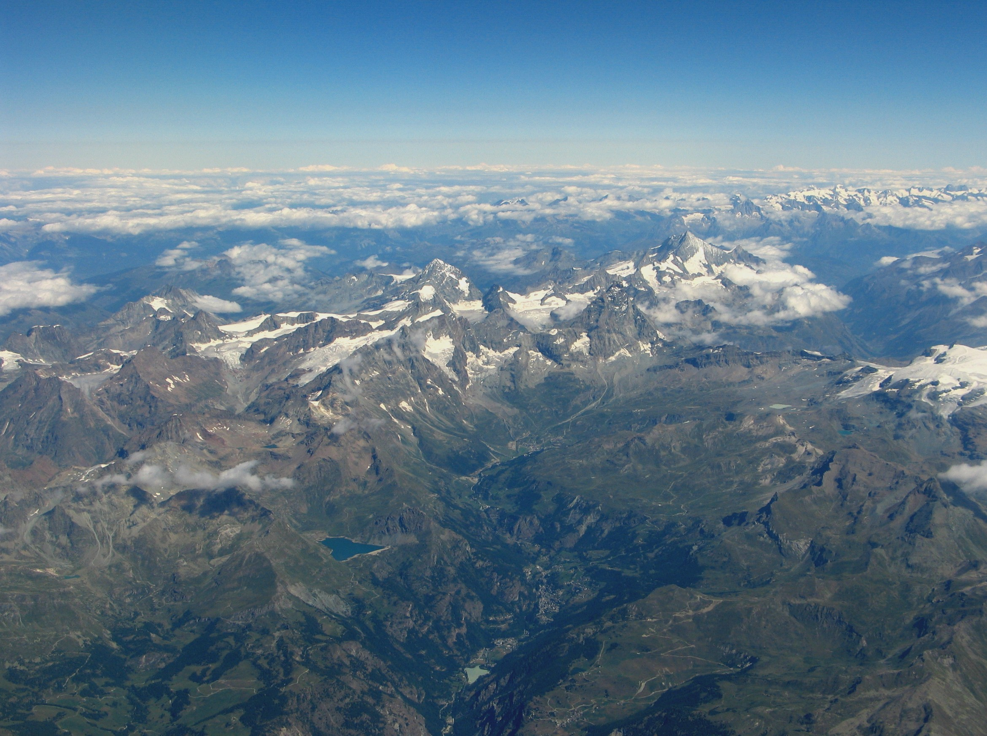
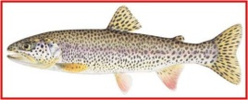
How do fish cross mountain ranges?
As the climate warms, trout can survive in the lower rivers
Notes:
How do fish cross mountain ranges? This has been a question scientists have speculated about for some time. Here is an animation of how cutthroat trout might have been able to do it during the ice age.
The fact that some rainbow trout and cutthroat trout were able to cross the continental divide to get to the eastern side of the Rockies, or were able to cross mountain passes to enter the Great Basin has been an area of great geological and biogeographic debate. The most common explanation is that during the ice ages, glaciers flowed down into river valleys forming ice dams. These dams caused rivers to back up into large lakes that ended up overflowing across the continental divide and reversing their flow. Fish that were trapped above the ice dams were able to swim the opposite direction to colonize new river systems. When the ice age ended and the lake drained into its original river valley, the trout populations became isolated on opposite sides of the divide.

Slide 15
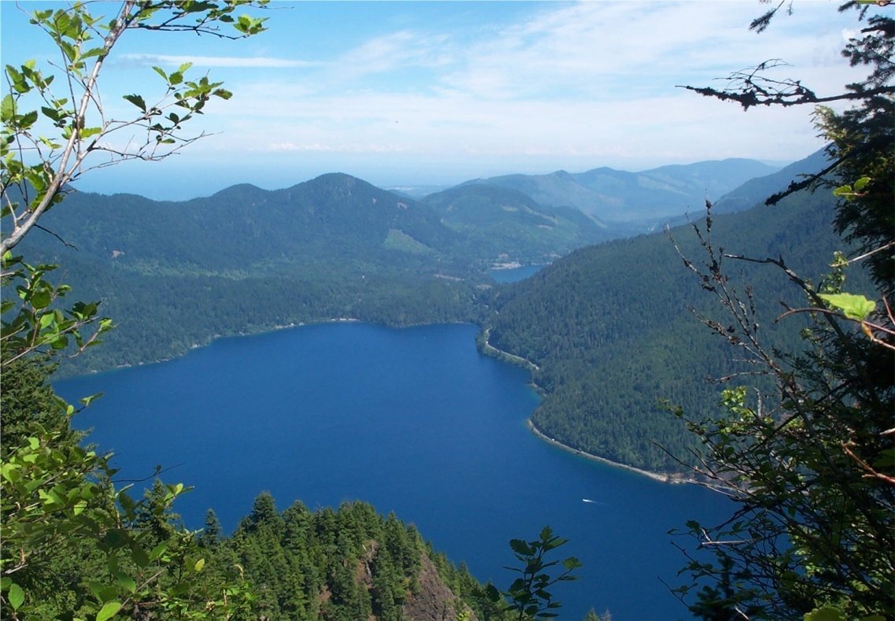
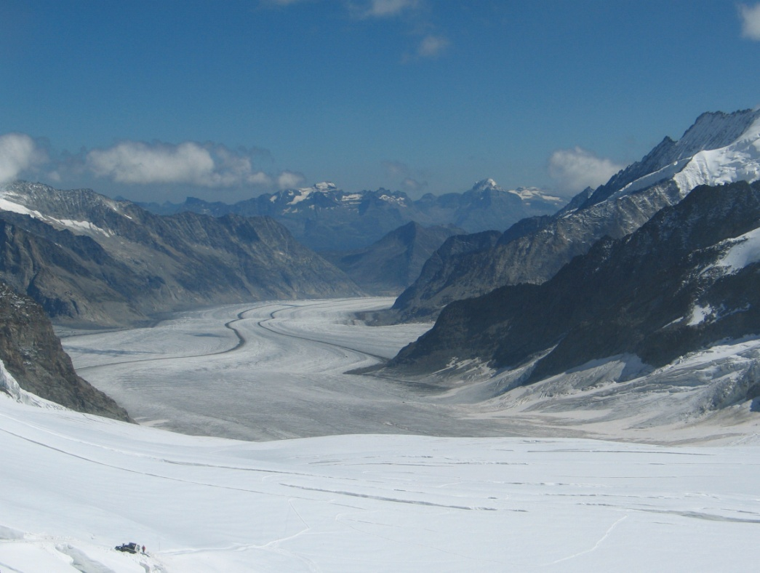
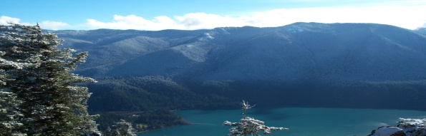
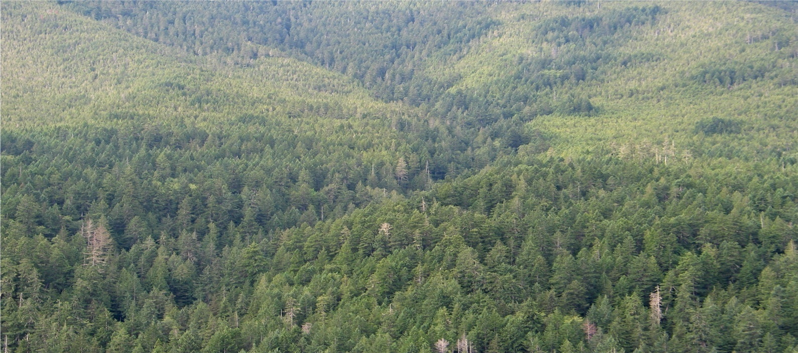
Beardslee and Crescenti Cutthroat Trout in Lake Crescent
Notes:
During the ice age, the area around Lake Crescent area was under a large valley glacier. When the glacier melted, it left a deep valley where Indian Creek flowed down into the Elwha River (There was probably a small lake or series of lakes in the deep glacially-carved pockets of the valley). Migrating steelhead and coastal cutthroat trout in the Elwha river would have colonized the Indian creek valley. However, about 9,000 years ago, a large landslide collapsed into the valley and blocked Indian creek. The valley filled with water some 600 feet deep. Eventually it found a low spot to drain out via the Lyre river valley. However, because the Lyre river drops over a waterfall not far from the outlet, fish in the new Lake Crescent were trapped in the lake and unable to go to sea. Rainbow trout evolved in isolation into the Beardslee trout, while coastal cutthroat trout became crescenti cutthroat trout.

Slide 16
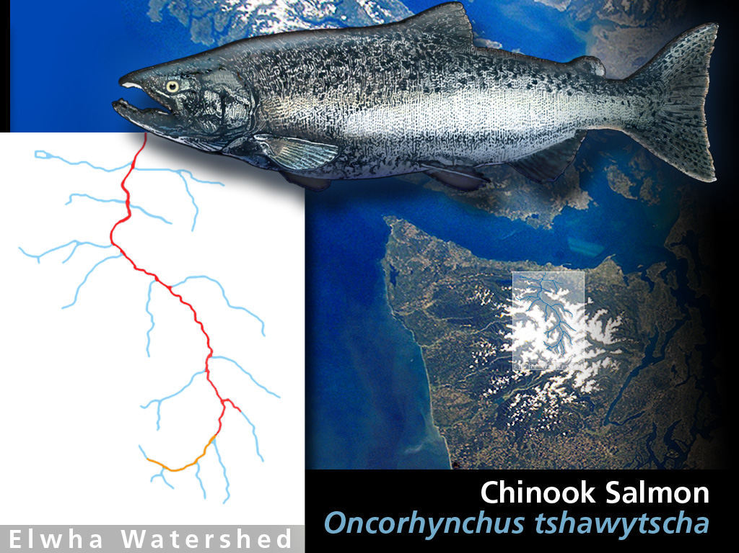
Seasonal Runs
Notes:
Several species of salmon develop into seasonal runs that although running the same river are temporally isolated.
One example are the fall and spring chinook. Spring chinook experience high water levels and cold temperatures due to the melting snow.
Fall chinook experience low water levels and higher temperatures, because the snowpack has melted and the water is coming from springs.
The obstacles, available spawning grounds, velocity of the water, and many other factors are different, even in the same river, so the adaptations these salmon need to be successful in the river also have to be different.
Since they come up the river at different times of the year, there is little to no genetic mixing of these runs, so they can diverge almost as much as salmon located thousands of miles apart.
The red line shows the furthest extent of the chinook fall run, while the orange line shows the chinook spring runs. Notice that spring run chinook can travel further up the river. This is due to the high flows related to snow melt, which allow the chinook to get up higher into sections of the river which would otherwise be too shallow to access.

Slide 17
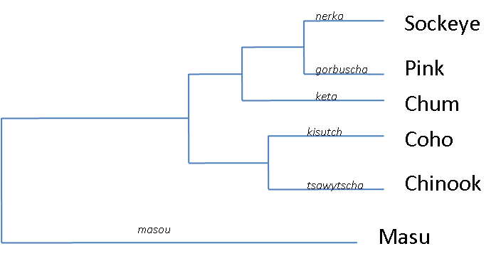
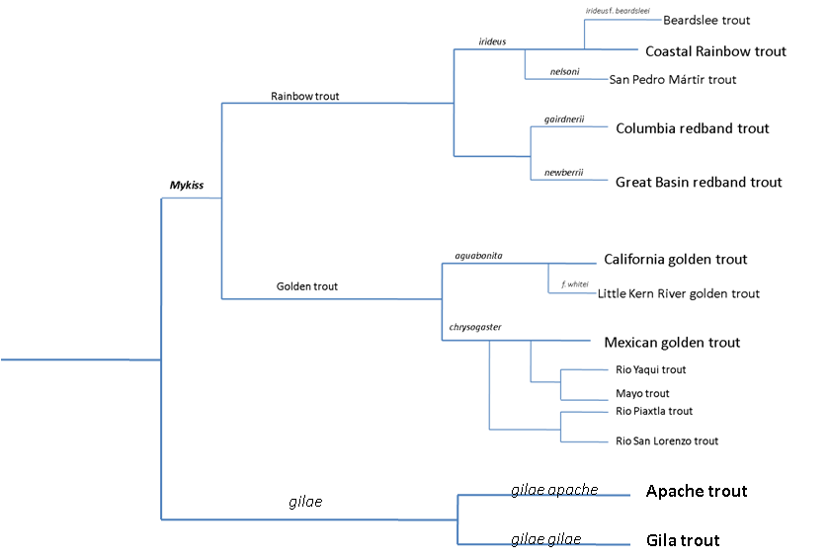
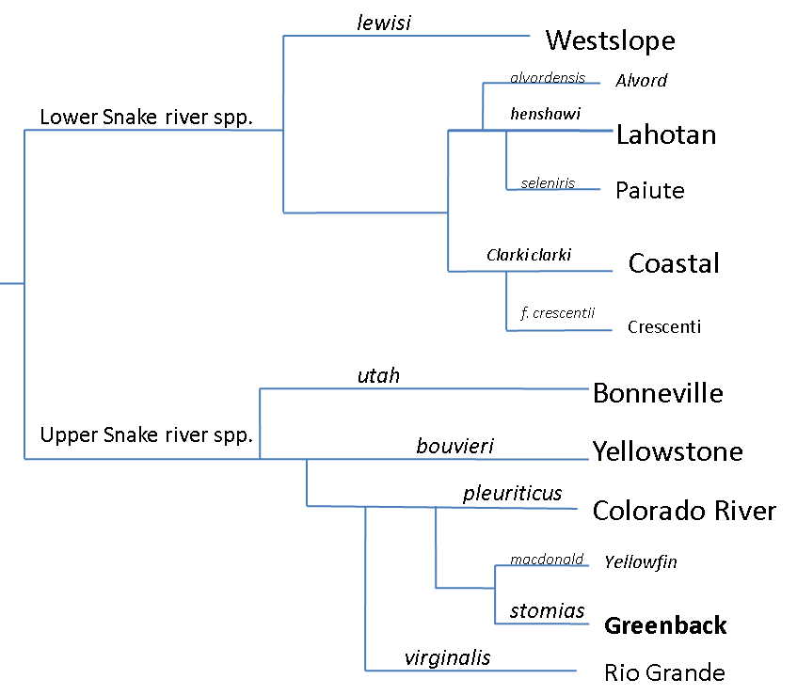
Pacific Salmon
Rainbow
Oncohynchus
Cutthroat trout
Notes:
Here is the full phylogenetic tree for the genus Oncorhynchus

Slide 18
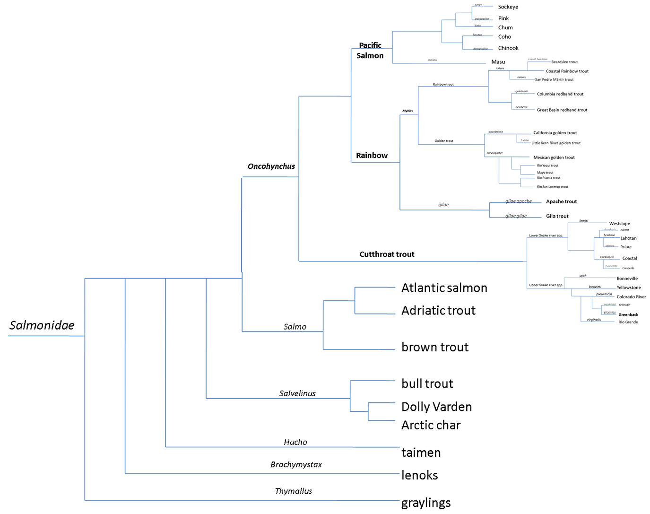
Notes:
Here is the full phylogenetic tree for the family Salmonidae

Slide 19

This project was made possible in part by a grant from
Washington’s National Park Fund.

